Slide 1
Fitness App to workout in Home
Aathidya varman.R
Date: 29 - 06 - 2022

Slide 2
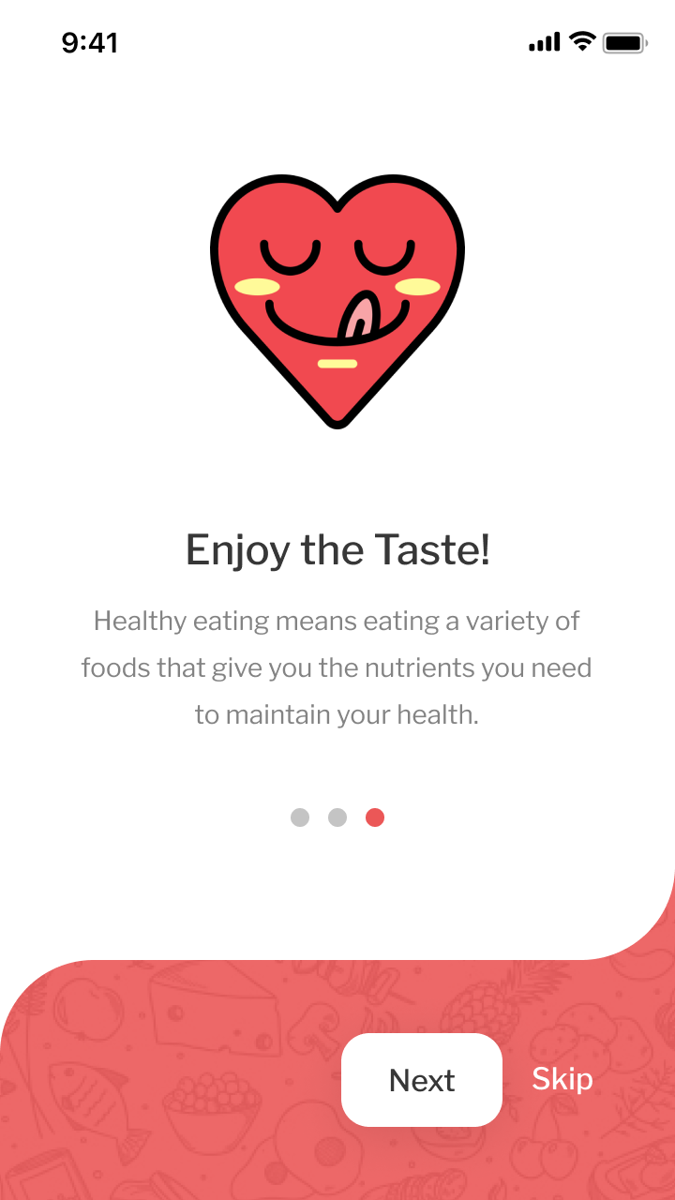
Project overview
Overview
I designed an fitness app with a goal to engage more lads who are working people from morning to evening and barely get time to do some workout due to extensive work pressure and busy with social life. .
Preview of selected polished designs.
Project duration:
May 2022 to July 2022

Slide 3
Project overview
The problem:
People who can’t go to the gym generally rely on home workouts and other outdoor activities but overall body growth must be required.
The goal:
The primary goal is to solve problems and help in the home workouts.

Slide 4
Project overview
My role:
Solo Ux Designer
Responsibilities:
Ux Research, UI design, Ux Writing and Usability Studies

Slide 5
User research
Personas
Problem statements
User journey maps
Affinity Diagrams
Understanding
the user

Slide 6
User research: summary
Survey, Direct Interviews, Empathy maps, Personas, User journey maps, Competitive Audit

Slide 7
User research: pain points
1
2
3
4
Time
Motivation
Act to plan
Shyness
Busy Professionals do not have time to go to gym
People did not have motivation to keep their body fit
Cannot follow the diet plan for a long period of time.
Many people become shy to go gym.

Slide 8
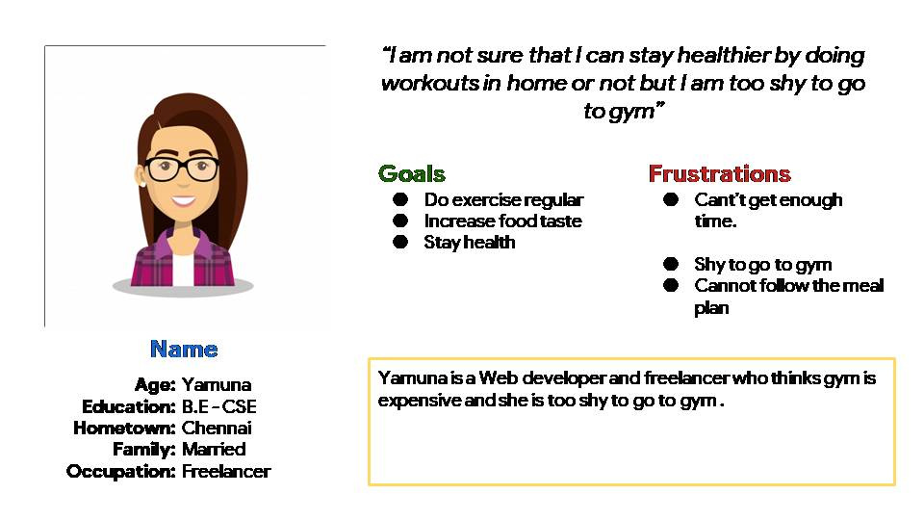
Persona:Yamuna
Problem statement:
Yamuna is a Freelancing Web developer who needs to to meet lot of clients and does not have time and feel shy to go to gym
.

Slide 9
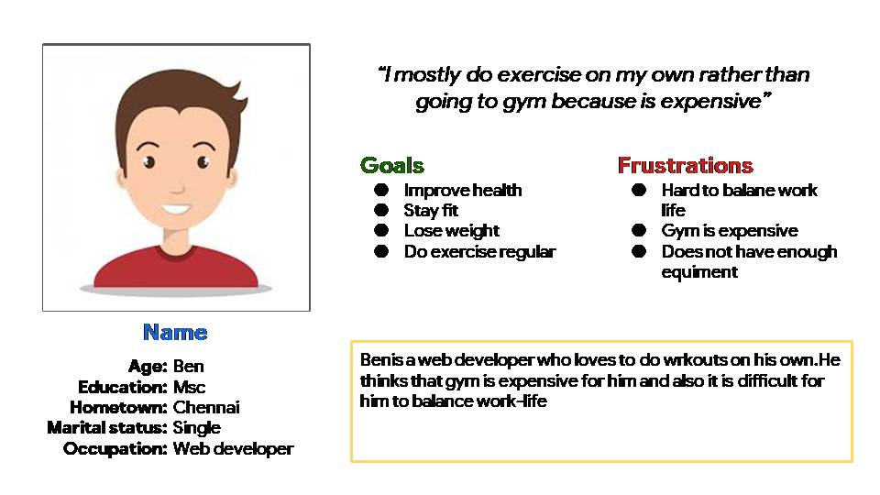
Persona: Ben
Problem statement:
Ben Anand is a Web developer
who likes to do exercise on his own and he thinks going to gym is too expensive.

Slide 10
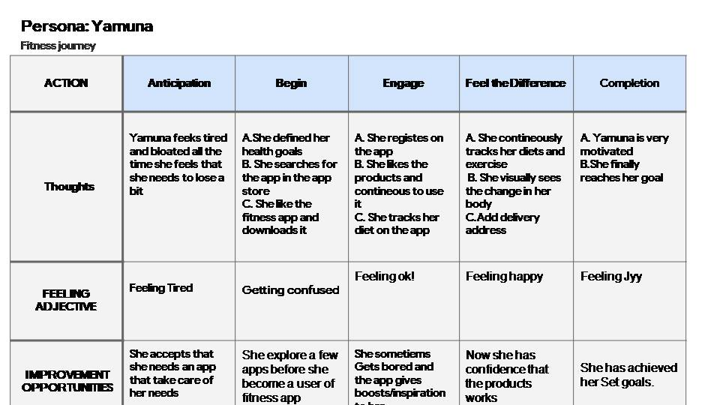
User journey map
Image of user journey map

Slide 11
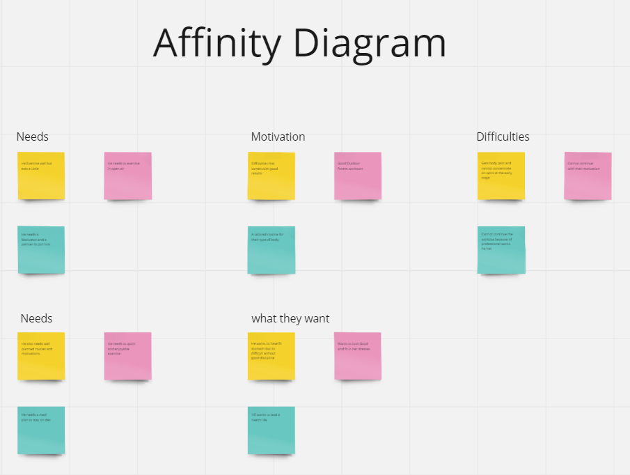
Affinity diagram
Image of user journey map

Slide 12
Digital wireframes
Low-fidelity prototype
Usability studies
Starting
the design

Slide 13
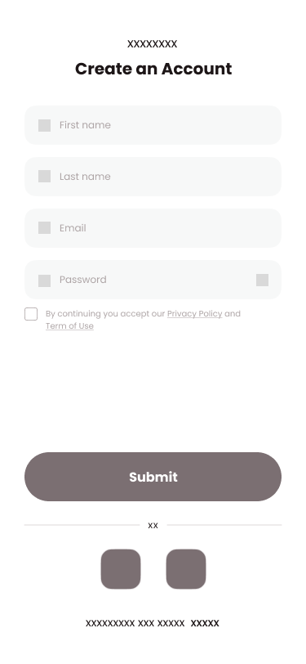
Digital wireframes
Register page
[Register screen]
\
List of poplar Items

Slide 14
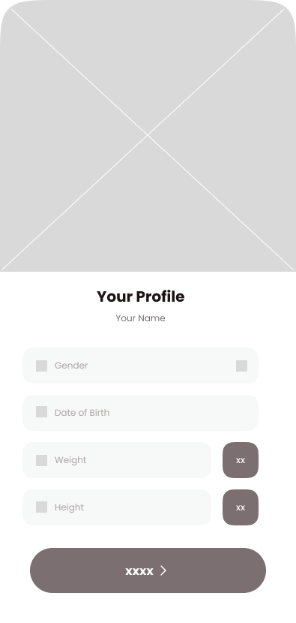
Digital wireframes
[User Info page]
Getting info about user
CTA confirm

Slide 15
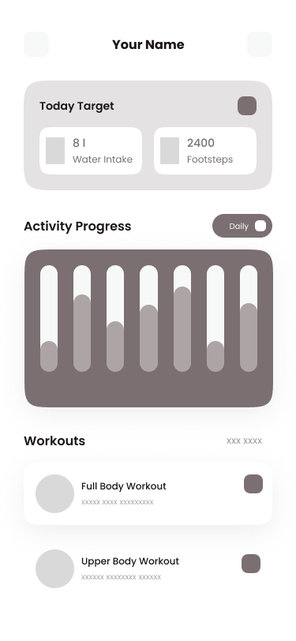
Digital wireframes
[Home page]
Weekly activity tracker

Slide 16
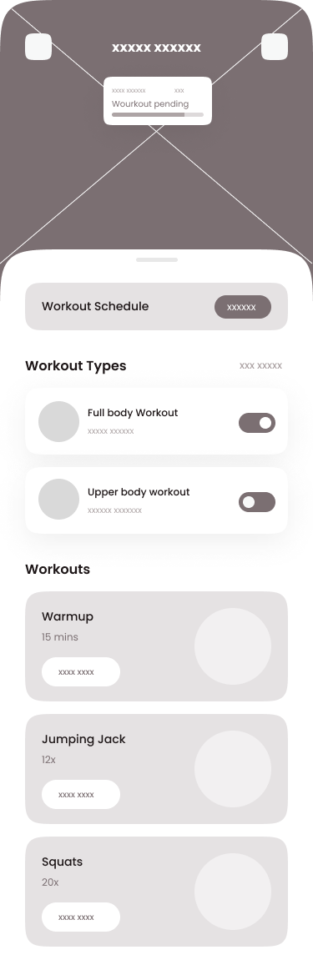
Digital wireframes
[type of workout
Schedules
Workout types

Slide 17
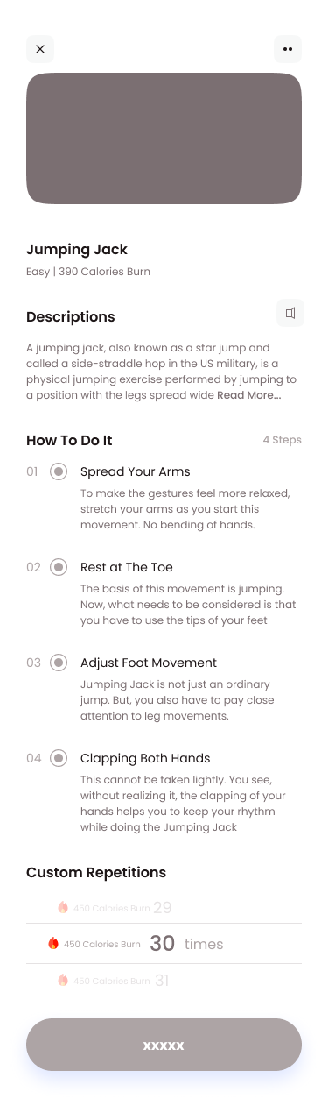
Digital wireframes
[workout page]
Description on how to do the workouts

Slide 18
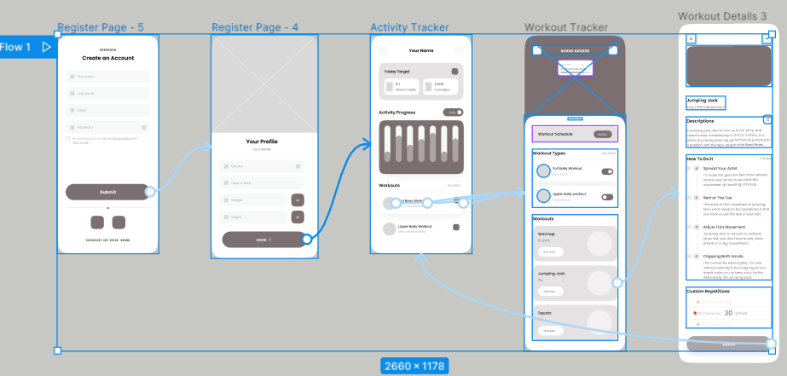
Low-fidelity prototype
[https://www.figma.com/proto/CVlxufG8DCfXxte6Id0EZt/Fitness-app?node-id=804%3A2556&scaling=min-zoom&page-id=206%3A281&starting-point-node-id=804%3A2556&show-proto-sidebar=1]
Screenshot of prototype with connections or prototype GIF

Slide 19
Usability study: findings
Write a short introduction to the usability studies you conducted and your findings.
Round 1 findings
1
felt uncomfortable to add their weights and heights
2
(Participants felt easy on choosing the workouts they need to
Had trouble in reading the description the workouts
3

Slide 20
Refining
the design
Mockups
High-fidelity prototype
Accessibility

Slide 21
Usability study: findings
Write a short introduction to the usability studies you conducted and your findings.
Round 1 findings
Round 2 findings
1
felt uncomfortable to add their weights and heights
1
Black color is not suitable
2
Participants felt easy on choosing the workouts they need to
2
Activity and tracker is on same page
Had trouble in reading the description the workouts
3

Slide 22
High Fidelity Mockupss
https://www.figma.com/proto/CVlxufG8DCfXxte6Id0EZt/Fitness-app?node-id=820%3A2812&scaling=min-zoom&page-id=206%3A281&starting-point-node-id=820%3A2812&show-proto-sidebar=1

Slide 23
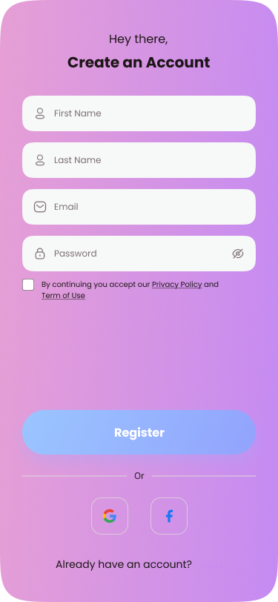
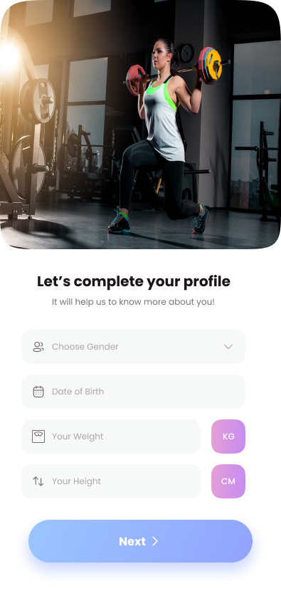
High Fidelity Mockupss
[Register page]
[User info page]

Slide 24
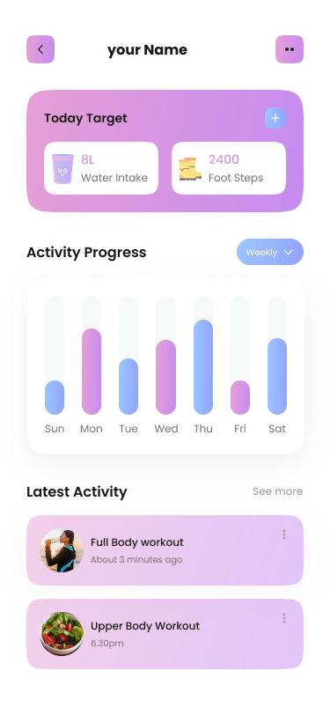
High Fidelity Mockupss
[Home page]

Slide 25
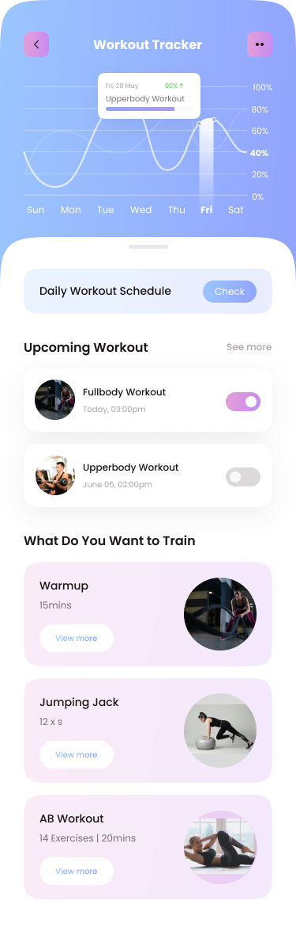
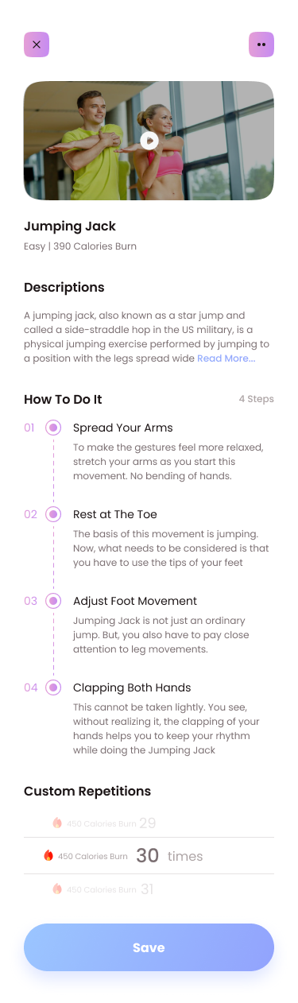
High Fidelity Mockupss
[Type of workout page]
[Workout page]

Slide 26
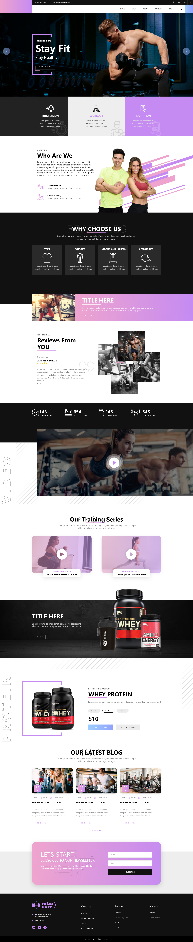
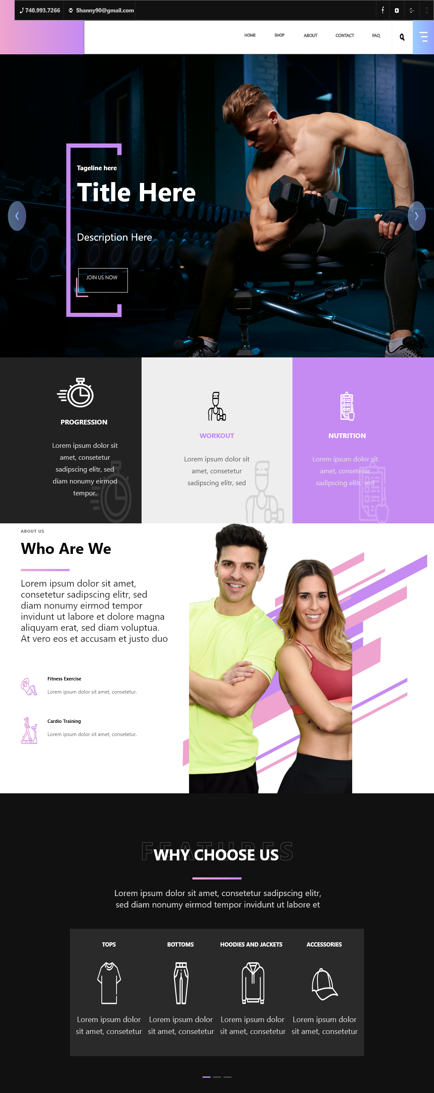
Desktop and Tablet view
[Desktop view]
[Desktop view]

Slide 27
Accessibility
Clear labels for interactive elements that can be read by screen readers
Gives primary task to the readers

Slide 28
Takeaways and next steps
Testing for final prototype needs to be done
Fidelity links should be sent to Developer

Slide 29
Next Steps
Conduct research on how successful the app in terms fulfilling users goals
Provide motivating stories to the users

Slide 30
Thankyou

